Slide 1
1. Given the following binary tree:
tree
45
38
65
34
41
63
72
16
35
39
44
55
64
(a) What is the inorder traversal of the tree?
16,34,35,38,39,41,44,45,55,63,64,65,72
(b) What is the preorder traversal of the tree?
45,38,34,16,35,41,39,44,65,63,55,64,72
(c) What is the postorder traversal of the tree?
16,35,34,39,44,41,38,55,64,63,72,65,45
What is the height of the tree? What nodes are on level 2?
The height is 4. Level 2: 34,41,63,72

Slide 2
2. Given the following binary expression tree:
tree
*
/
+
-
24
-
12
48
%
18
*
7
2
5
2
What is the inorder traversal of the tree?
((48-(7%2))/24) * ((18-(5*2))+12)
(b) What is the postorder traversal of the tree?
48 7 2 % -24 / 18 5 2 * -12 + *
What does it evaluate to if using integer division?
20
What does it evaluate to if using float division?
39.16

Slide 3
The elements in a binary tree area to be stored in an array. Each element is a
nonnegative int value.
a. What value can you use as a dummy value, if the binary tree is not complete? null_
b. Show the contents of the array, given the tree illustrated below
[0]
[1]
[2]
[3]
[4]
[5]
[6]
[7]
[8]
[9]
[10]
[11]
[12]
[13]
[14]
14
tree
73
14
21
7
73
21
null
19
6
7
19
6
null
51
null
51
45
null
null
null
null
45

Slide 4
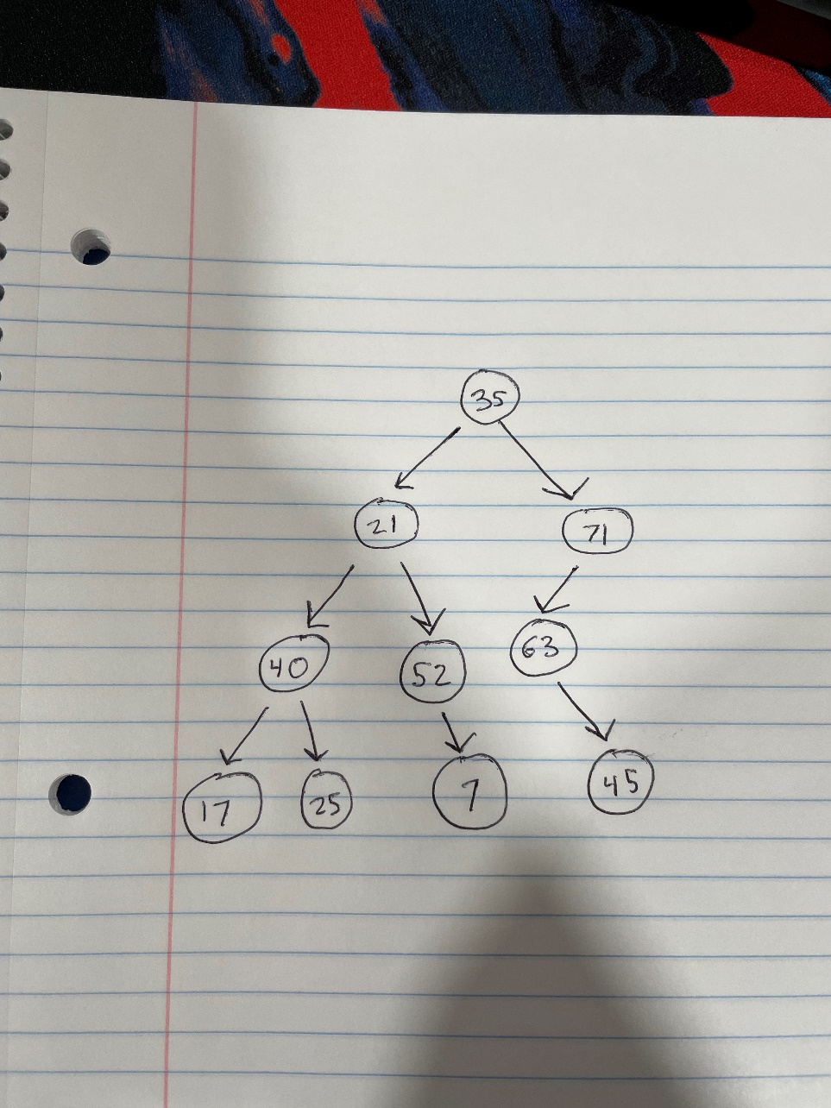
Given the array pictured below, draw the binary tree that can be
created from its elements.
35
20
71
40
52
63
null
17
25
null
7
null
45
[0]
[1]
[2]
[3]
[4]
[5]
[6]
[7]
[8]
[9]
[10]
[11]
[12]

